Slide 1


TRAFFIC SIGN RECOGNITION & CLASSIFICATION
ML – DL Project : A Deep Learning Approach Using CNN For
Supervised by :
Dr.Joaquin RODRIGUEZ
Presented and Factored by : Mariam Janbein | Adel Kanso | Mehdi Cheria | Samer Shili
Notes:
Today we gonna present our project which traffic sign recognigtion and clisffication based on deep learnin the goal of our work is to design a system which is accurate efficient and robust for real world conditions

Slide 2
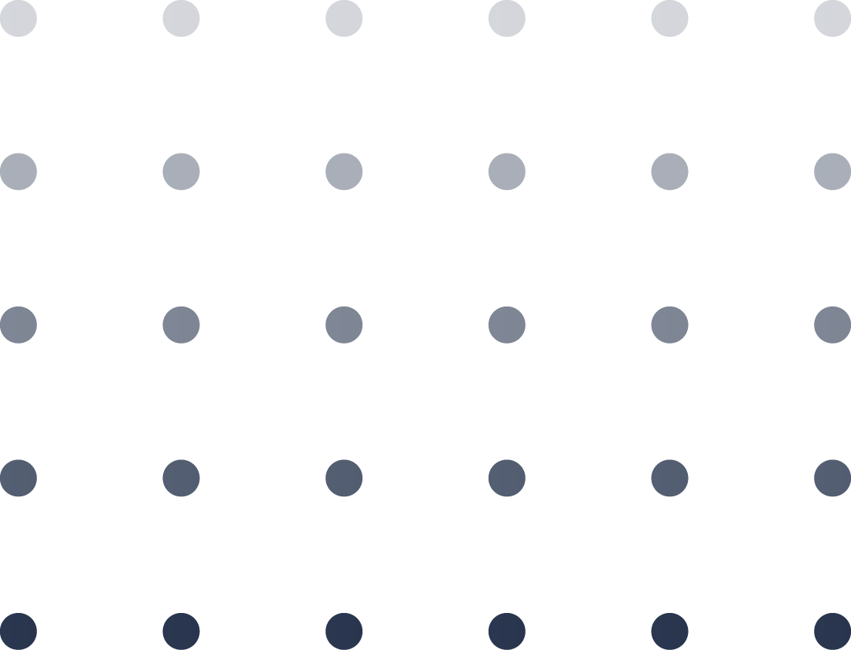
TABLE OF CONTENTS
01
02
03
04
INTRODUCTION
METHODOLOGY
RESULTS & ANALYSIS
CONCLUSION
2
Notes:
Our presentation is structured as follows
First we gonna star with our motivation and our problem definition
Second we gonna explain our methology including data processing and our model design
After that we gonna present and analyzes the results
Finally we arrive to conclusions and perspectives

Slide 3

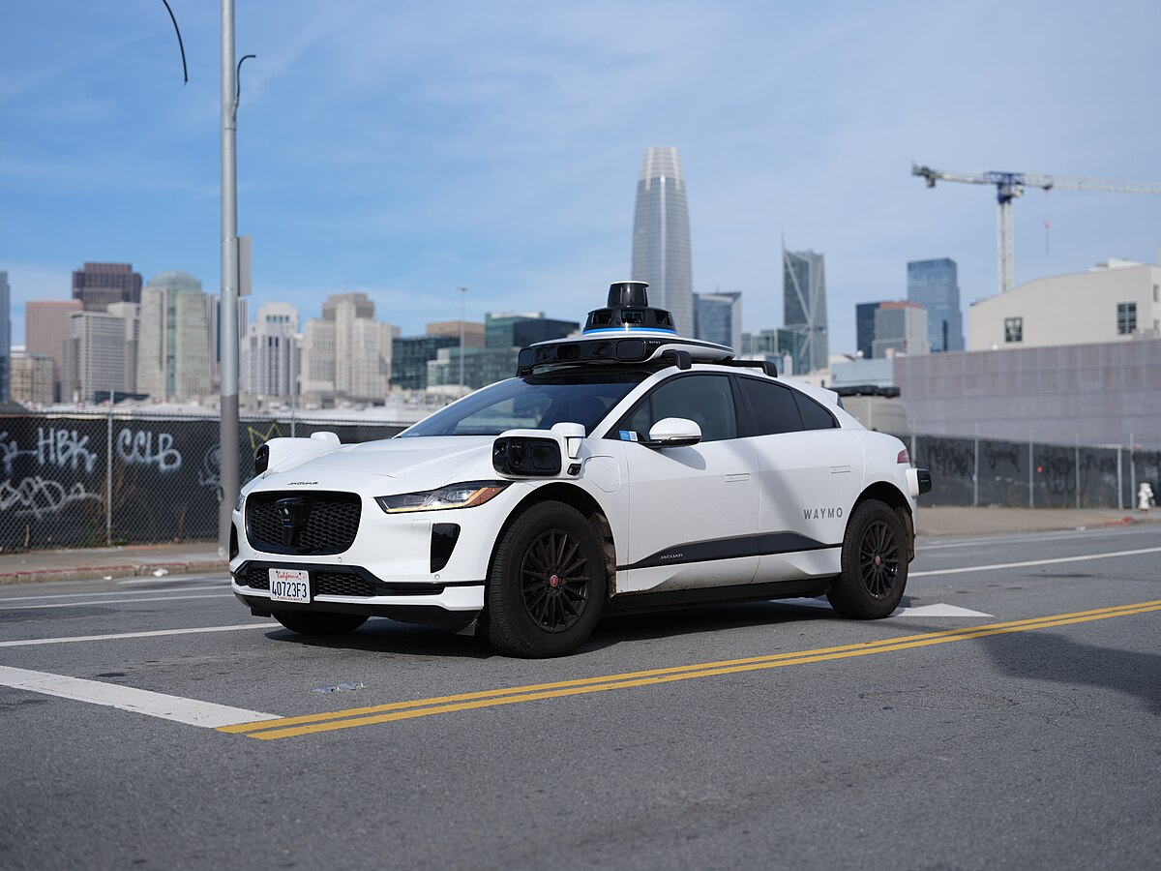
Motivation & Context
Traffic sign recognition is critical for:
Autonomous driving
Advanced Driver Assistance Systems (ADAS)
Human limitations:
Poor lighting
Occlusion
High speed
Computer vision systems must be:
Accurate
Robust
Fast
3
Notes:
Today traffic sign recognition is a critical component in intelligent transportation systems , it has a critical role in autonomous driving and advanced driver assistance systems
However we as humans has a limitations , as drivers we can miss some signs due to poor lightning or high speed , or occlusion with other drivers
That’s why computer vision systems should satisfy the real world requirement which are accurate and robust and fast for real time decision making

Slide 4
Problem Definition & GOAL
THE GOAL
CLASSIFIER
RGB image
Traffic Sign Class Label
CHALLENGES
Illumination changes
Motion blur
Class imbalance
High inter-class similarity
Real-time constraints
4
Notes:
So that’s the overview of our goal is designed like this , we have an input as rgb input image giving it to our classifier to get a traffic sign class label
From the first sight we can say that is a simple task to do but the task is challenging due to real world factors which aare illimunation changes , motion blur high similarity between sighns and we should respect the real time contraints

Slide 5

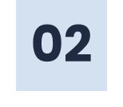
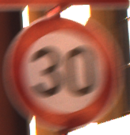
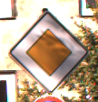
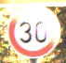
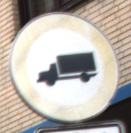
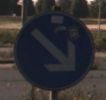
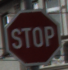


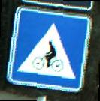
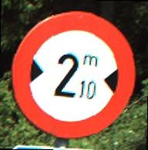
Datasets Used
German Traffic Sign Recognition Benchmark (GTSRB)
≈ 39,000 training images
≈ 12,600 testing images
43 classes
BelgiumTS Dataset ( Used for Multi model comparaison)
62 classes
≈ 4,500 training images
≈ 2,500 testing images
5
Notes:
To solve these challenges we used a data that already contain the real world difficulties
The gtsrb data set includes traffic sign that contain 43 classes of signs that captured under different condition , blur , shadows low resolution and night time illimunation
Also we used the belguim data for seeing how well our model generaliwes to a different contry sigh and ditibution and also to cmpare with other models

Slide 6
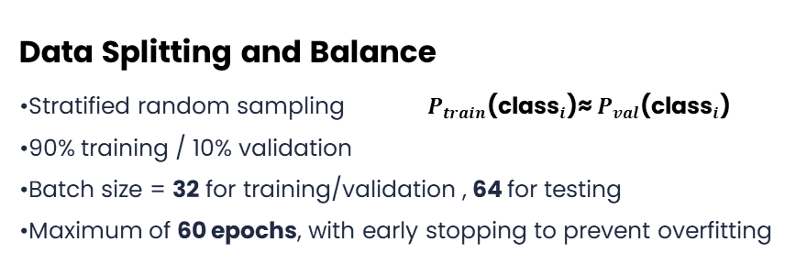
Data Processing
Standardization Pipeline
Resize to 32×32 pixels
Normalize pixel values to [0, 1]
Convert to tensors (C,H,W)
Data Augmentation
Minority class duplication
Each duplicate receives random augmentation:
* Rotation: ±45°
* Brightness / Contrast: ±20%
Data Splitting and Balance
Stratified random sampling ${ P}_{train}\text{(}{\text{class}}_{i}\text{)}\text{≈} P_{val}\text{(}{\text{class}}_{i}\text{)}$
90% training / 10% validation
Batch size = 32 for training/validation , 64 for testing
Maximum of 60 epochs, with early stopping to prevent overfitting
6
Notes:
Finally the dataset is split using stratified random sampling , ensuring that class distribution remain consistent between training and validayion and for that we are using 90 oercent of data set in training and 10 percent of it in tsting with appropriate batch size 32 and max numbr of epochs 60 with early stoping

Slide 7
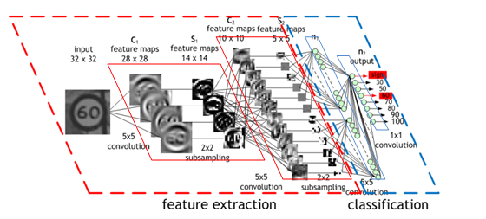
What is & Why CNN ?
Model Characteristics:
Designed for images
Captures edges, shapes, colors
Robustness over rotation and lightning
Preserves spatial information
Reason for Choice:
Dataset is small images
Traffic Signs have multiple shapes, colors
Different rotations and lightning
Traffic Signs has symbols and texts
7

Slide 8
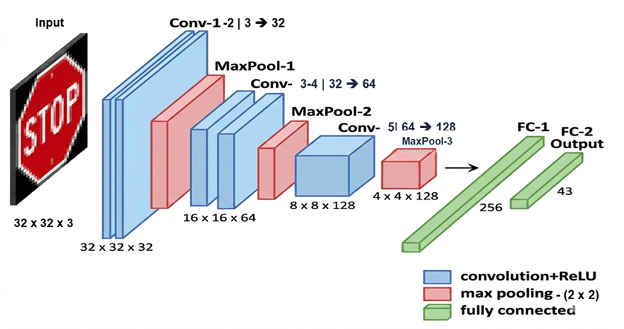

CNN Architechture Overview
Input: (3, 32, 32)
│
├─ Conv2d(3→32, 3x3, pad=1) → ReLU → (32, 32, 32)
├─ Conv2d(32→32, 3x3, pad=1) → ReLU → (32, 32, 32)
├─ MaxPool2d(2x2) → (32, 16, 16)
├─ Dropout(0.25)
│
├─ Conv2d(32→64, 3x3, pad=1) → ReLU → (64, 16, 16)
├─ Conv2d(64→64, 3x3, pad=1) → ReLU → (64, 16, 16)
├─ MaxPool2d(2x2) → (64, 8, 8)
├─ Dropout(0.25)
│
├─ Conv2d(64→128, 3x3, pad=1) → ReLU → (128, 8, 8)
├─ MaxPool2d(2x2) → (128, 4, 4)
├─ Dropout(0.3)
│
├─ Flatten → 2048
├─ Linear(2048→256) → ReLU
├─ Dropout(0.5)
├─ Linear(256→43)
│
Output: (43)
8
Notes:
Our architecture follows a principled design strategy: we start with low-level feature extraction using small kernels and progressively increase channel depth as spatial resolution decreases. ReLU activations ensure stable gradient propagation, while progressive dropout provides increasing regularization as features become more abstract. Finally, the compact nature of the model ensures real-time performance without sacrificing accuracy.

Slide 9
Architecture Design Justification
WHY 32 x 32 ?
Why 3 x 3 Kernel ?
Key features: shape, color, symbols
Do not require high-resolution textures
Smaller input → lower latency & computational complexity
Two stacked 3×3 kernels ≈ effective 5×5 receptive field
Fewer parameters :
- 5×5 kernel: 25 parameters
- Two 3×3 kernels: 18 parameters
Why ReLU ?
WHY Dropout ?
Computationally cheap
Sparse activations
Avoids vanishing gradients
No dead ReLU problem observed
Improves generalization
Prevents co-adaptation of neurons
Improves redundancy
Notes:
Why relu ?
Negative activations may matter in audio processing , signal , physics based model
Filters detect what the other ignors
negative responses typically correspond to non-detected features or background.
Sigmoid/ tanh saturates → slow learning
Why dropout ?
Dropout 0.25 ➔ learn redundant and robust low level features
Dropout(0.30) ➔ Higher risk of overfitting
Dropout(0.50) ➔ Highest risk of memorization

Slide 10
Architecture Design Justification
Why Max Pooling ?
Why 3 x 3 Kernel ?
Preserves dominant features
Reduces noise
Preserves spatial details
Fewer parameters :
- 5×5 kernel: 25 parameters
- Two 3×3 kernels: 18 parameters
Why ReLU ?
WHY Dropout ?
Computationally cheap
Avoids vanishing gradients
Reduce noise
Improves generalization
Prevents co-adaptation of neurons
Improves redundancy
10
Notes:
Why relu ?
Negative activations may matter in audio processing , signal , physics based model
Filters detect what the other ignors
negative responses typically correspond to non-detected features or background.
Sigmoid/ tanh saturates → slow learning
Why dropout ?
Dropout 0.25 🡺 learn redundant and robust low level features
Dropout(0.30) 🡺 Higher risk of overfitting
Dropout(0.50) 🡺 Highest risk of memorization

Slide 11
Architecture Design Justification
WHY this channel Expansion ?
Why MaxPooling ?
Increasing number of filters as spatial resolution decreases
Early layers: detect edges and colors
Deeper layers: capture complex shapes and symbols
Preserves dominant features
Reduces noise
Notes:
Why relu ?
Negative activations may matter in audio processing , signal , physics based model
Filters detect what the other ignors
negative responses typically correspond to non-detected features or background.
Sigmoid/ tanh saturates → slow learning

Slide 12
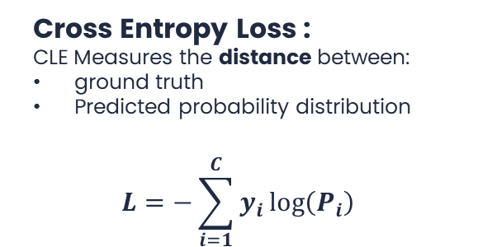
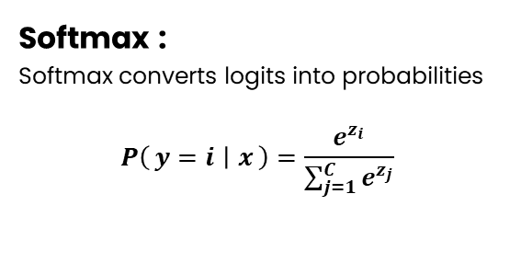
How We Mesure The Error ?
Softmax :
Softmax converts logits into probabilities
$$P\left(y=i ∣ x\right)=\frac{e^{z_{i}}}{\sum_{j=1}^{C}{e^{z_{j}}}}$$
Cross Entropy Loss :
CLE Measures the distance between:
ground truth
Predicted probability distribution
$$L=−\sum_{i=1}^{C}{y_{i}}\log\left(P_{i}\right)$$
12
Notes:
Softmax : CNN outputs (raw numbers) , not probabilities
Softmax answers the question: “Given this image, how confident is the model that it belongs to each class?”
CLE :
High confidence & correct → low loss
High confidence & wrong → very high loss

Slide 13
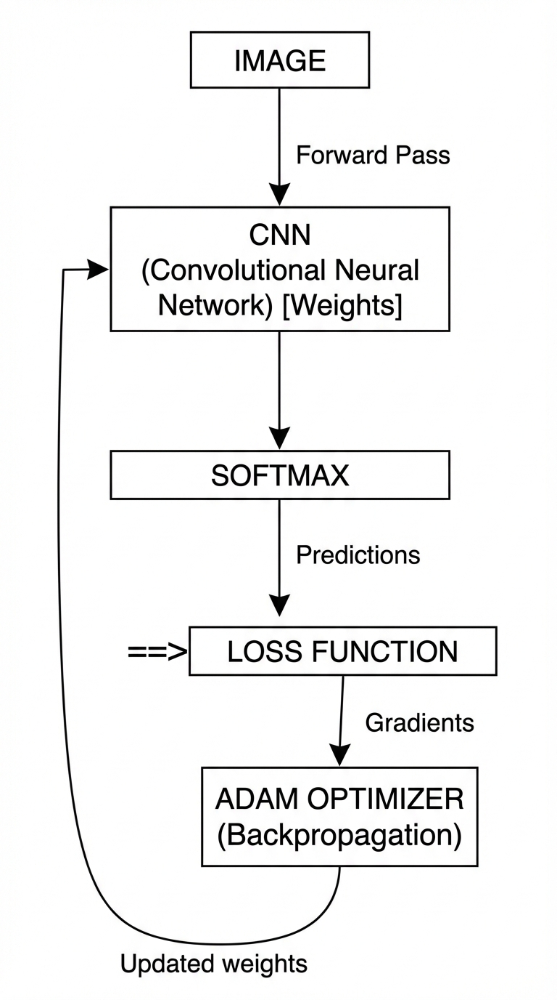
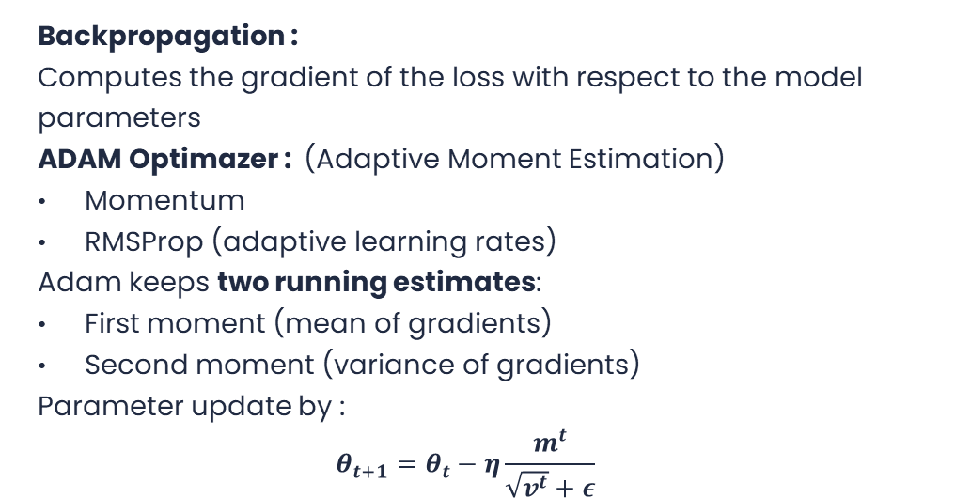
How We reduce The Error ?
Backpropagation :
Computes the gradient of the loss with respect to the model parameters
ADAM Optimazer : (Adaptive Moment Estimation)
Momentum
RMSProp (adaptive learning rates)
Adam keeps two running estimates:
First moment (mean of gradients)
Second moment (variance of gradients)
Parameter update by :
$$θ_{t+1}=θ_{t}−η\frac{m^{t}}{\sqrt{v^{t}}+ε}$$
13
Notes:
WHY BASIC GRADIENT DESCENT IS NOT ENOUGH
Problems:
Same learning rate for all parameters
Sensitive to noisy gradients
Slow convergence
📌 CNNs have millions of parameters → smarter optimizer needed

Slide 14
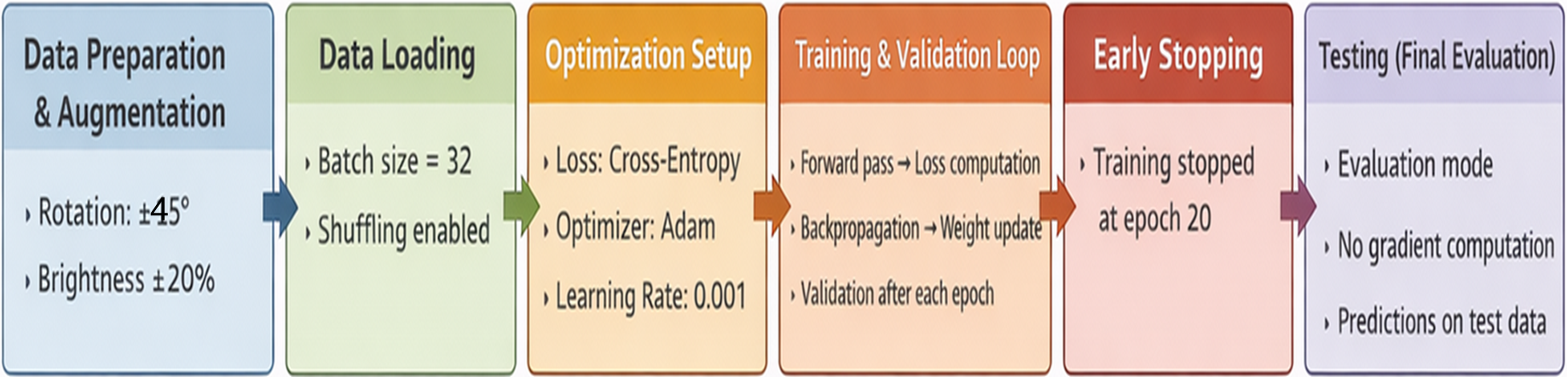
Training & Testing Pipeline
14
Notes:
Why relu ?
Negative activations may matter in audio processing , signal , physics based model
Filters detect what the other ignors
negative responses typically correspond to non-detected features or background.
Sigmoid/ tanh saturates → slow learning

Slide 15

Training Dynamics
15
Notes:
The custom CNN achieved stable convergence on GTSRB within 20 epochs :
• Training Accuracy: Rapid ascent to >90% by epoch 8, reaching 93+% by epoch 13
• Validation Accuracy: Reached 98.04% by epoch 6
• Training Loss: Decreased from 2.5 to <0.25 by epoch 15
• Validation Loss: Reached minimum at epoch 13 (0.12), increased slightly to 0.14 by epoch 18

Slide 16
Per-Class Accuracy
16

Slide 17
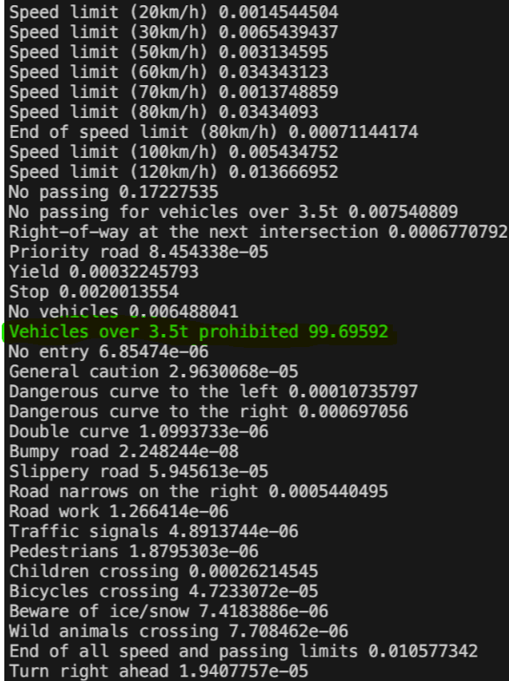
Single Image Probability Analysis
17
Notes:
For a "Stop" sign image, all classes predected near zero values example:
Roundabout mandatory 0.00023949606 End of no passing 0.0009149968 End of no passing for vehicles over 3.5t 1.8302613e-05
the correct class Vehicles over 3.5t prohibited 99.69592

Slide 18
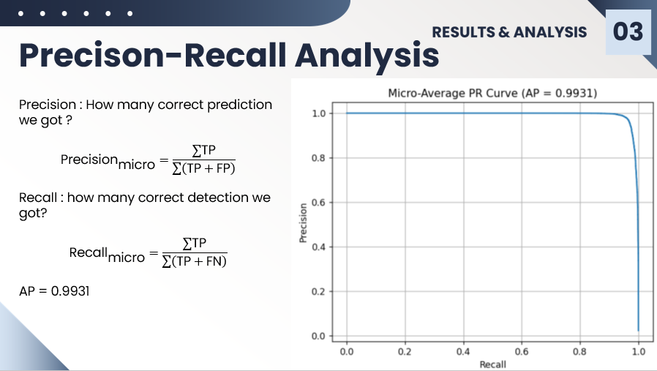
18

Slide 19
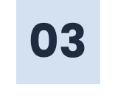
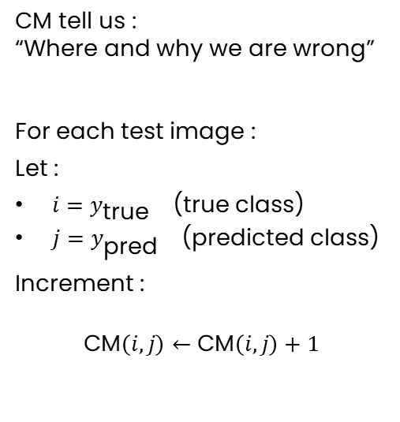
Confusion Matrix
CM tell us :
“Where and why we are wrong”
For each test image :
Let :
$i=y_{\text{true}}$(true class)
$j=y_{\text{pred}}$(predicted class)
Increment :
$$\text{CM}\left(i,j\right)←\text{CM}\left(i,j\right)+1$$
19
Notes:
Why Confusion Matrix Is Important
Accuracy tells:
“How often we are right”
Diagonal elements:
Correct classifications
Off-diagonal elements:
Misclassifications
Perfect classifier: Only diagonal values ≠ 0

Slide 20

20

Slide 21
21

Slide 22
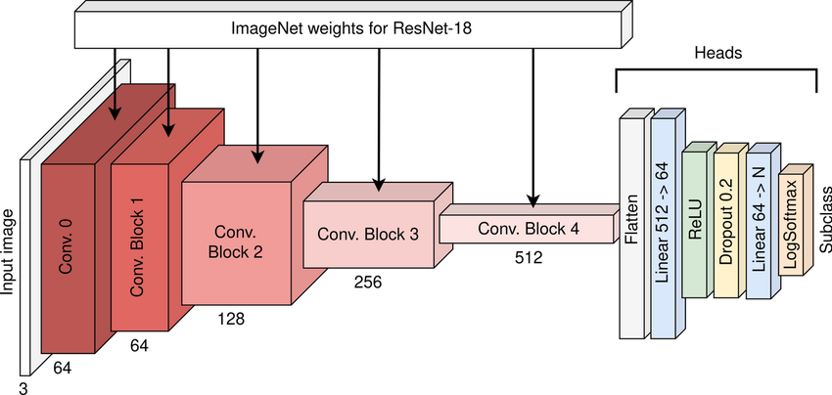
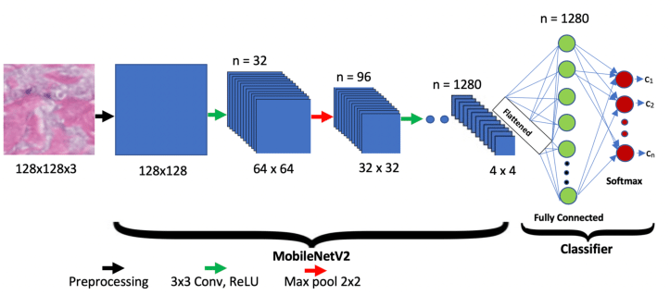
Alternative architectures
RESNET 18
MOBILE NET N2
22

Slide 23
Models Performance Comparison
Dataset | Model | Accuracy (%) | F1-Score (%) | Model Size (MB) | Inference Time (ms/img) | Training Time
GTSRB | Custom CNN | 96.48 | 96.50 | 2.58 | 0.12 | 00:24:16
 | ResNet18 | 93.54 | 93.75 | 42.79 | 0.28 | 01:24:46
 | MobileNetV2 | 96.46 | 96.43 | 8.93 | 0.11 | 00:53:39
BelgiumTS | Custom CNN | 96.94 | 97.07 | 2.70 | 0.09 | 00:01:57
 | ResNet18 | 97.34 | 97.53 | 42.83 | 0.32 | 00:14:47
 | MobileNetV2 | 94.21 | 94.38 | 9.02 | 0.14 | 00:09:41
23
Notes:
The custom CNN achieved stable convergence on GTSRB within 20 epochs :
• Training Accuracy: Rapid ascent to >90% by epoch 8, reaching 93+% by epoch 13
• Validation Accuracy: Reached 98.04% by epoch 6
• Training Loss: Decreased from 2.5 to <0.25 by epoch 15
• Validation Loss: Reached minimum at epoch 13 (0.12), increased slightly to 0.14 by epoch 18

Slide 24

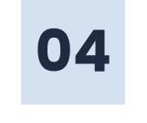

Perspectives
Real dashcam data
Night-time training data
Upgrade the project to detection and multidetection
Apply real time système of recognition and multidetection
24

Slide 25
Conclusion
CNNs are effective for traffic sign recognition
Comparing models helps understand accuracy vs. efficiency trade-offs
Custom CNN offers a good balance between performance and speed
Deeper models improve generalization but increase computational cost
Suitable foundation for real-time traffic perception systems
25

Slide 26
THANKS!
26

